Slide 1

Let Us Yelp You
Leveraging Data from Yelp to Create New Restaurants
WINTER 2019, MSDS SEC58, Capstone Project
SPS, Northwestern University, Evanston, IL
Advisor: Nethra Sambamoorthi, Ph. D

Slide 2
Introduction
Who we are
The Client
Open Source Data
Experience
Let Us Yelp You
Marketing and Analytics Consultants
Analytically advise on the creation of successful restaurants
Yum! Brands
Leading restaurant group
Scoping new ventures in Phoenix, AZ
Notes:
Let Us Yelp You is a Marketing and analytics firm that provides guidance on opening a successful restaurant. We use open-source data as well as our own experience to provide valuable insights for aspiring restaurateurs. Our client is Yum! Brands, a leader in restaurant companies, who would like to expand their Phoenix, AZ market with a new restaurant. They have requested our assistance in researching area competition and providing options for their new restaurant.
We will ultimately create a real-time API with a dashboard that allows Yum! to choose various attributes of a restaurant and see the probability of it becoming highly-rated on Yelp, a review website where millions go daily to get insights on local businesses before they decide to patronize. The max rating is 5 stars. We define “highly-rated” as gaining 4.5 stars or higher, which would rank a restaurant in the top 15% of rated restaurants represented on the Yelp website.

Slide 3
The Data
What we use to get results

Slide 4
The Source
Open Source Dataset from Yelp
Provided with documentation about the structure of each data set
Data is As-Is
Primary set - Review and Business Data
Key Elements
Number of stars awarded
Amount of votes
Type of votes
Features of restaurants
Notes:
Our primary sources of data came from Yelp’s publicly available datasets. These included several separate data tables for the businesses, reviews and users as well as check-ins, photos, tips. We were also provided documentation regarding the structure of each dataset
Because this data was already precompiled and open source, we were unable to ask for any additional data or changes; however, once we analyzed the data, additional data was unnecessary in our case.
Among the available datasets, we primarily focused on the Review and Business data. The review table contains review information and the star rating associated with each review. The business table contains details on each specific business including the average review. Together, these tables contained the key elements needed for our analysis (Things like num of stars, amount and types of votes received, features of restaurants); therefore, a join of these two tables was our main source.
With our goal being to increase the probability of opening a successful new restaurant in a prime location, our response variable, also known as our key metric, was “stars” which is the average star rating for a restaurant.

Slide 5
The Approach
How we get results

Slide 6






The Steps
Explore the data
Clean the Data
Choose our variables
Analyze
Conclude
Create Dashboard
Notes:
We begin by analyzing our dataset. We’re looking to understand our data and looking for outliers, missing data and any preliminary patterns. Our next step is to clean the data by removing variables that are missing more than 50% of the data. Looking deeply into variables which have more than 2% of their data as outliers to determine a plan of action. We’ll also look to see if any variable will need to be transformed. Once our data is clean, we’ll focus on variable selection. We’ll look more into the data patterns to discard any variables that show no correlations to stars and determine which variables to keep. We’ll then analyze our data by running several models and determine which is best. We’ll then go over our results and determine our conclusions to create the Dashboard API.

Slide 7
Exploring the Data
Gaining insights

Slide 8
Exploring Our Data
Review and Business Sets
5,450,261 records, 24 columns
AZ specific: 486,825, 23 columns
Check for Missing data
Nested Variables
Attributes and Categories
Unnesting resulted in 91 columns
Notes:
Since Yum! Specifically requests a restaurant location in Phoenix, AZ, we pulled only the data where the state is “AZ”, category is “Restaurants” and city is “Phoenix”. This brought our dataset down to 486,825 records with 23 columns.
We checked each variable to determine the percent of missing data
Further analysis showed the “attributes” and “categories” variables as nested. Unnesting these variables was important because they contained lists of potentially valuable inputs to our analysis. The attribute variable contained very specific information about each restaurant: What is the ambiance like? Do they have outside seating? and more. The category variable classified the dining type as fast-food, Mexican, Italian, and many more options. We unnested these two variables which then gave us 91 total variables to work with. We checked again for missing data, and columns with greater than 50% of missing data were removed.

Slide 9
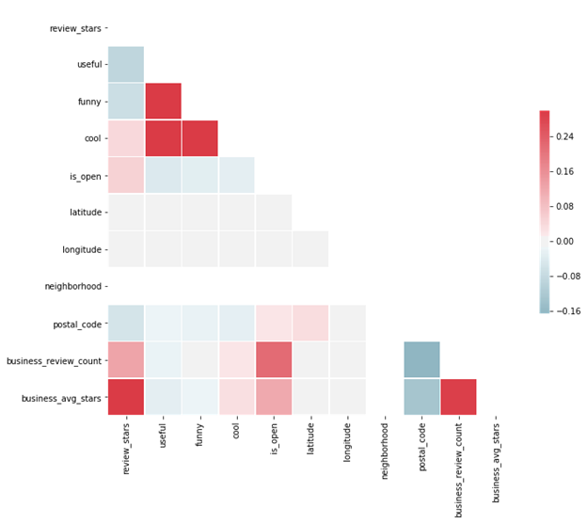
Correlation Pair Matrix
Review Data
44% positive correlations
0.22% neutral
50% impact on “stars”
Business Data
43% positive correlations
57% impact on “stars”
Users Data
36% positive correlations
64% impact on “stars”
Notes:
We used a correlation pair matrix to measure the shape of the distributions for skewness and verify the impact on the direction of our response variable - stars.
Of the datasets used, positive correlations were between 36-44%, and all sets had 50% of an impact on the response variable.

Slide 10

Cleaning the Data & Choosing variables
Creating a sound foundation

Slide 11
Data Cleansing & Variable Reduction
Variable Reduction
Not useful: user_id, business_id, address, city, state, hours, longitude, latitude, name, neighborhood and postal_code
Removed Variables - Missing data >50%
No Data Transformations
Notes:
After initial analysis of the content provided by each variable, we determined 11 variables (user_id, business_id, etc., listed here) would not be useful for our model.
As mentioned, any variables with more than 50% of missing data were dropped; for example, neighborhood was completely missing and was therefore dropped.
We also determined that our data did not need any transformations.

Slide 12
Analysis
Model implementation

Slide 13
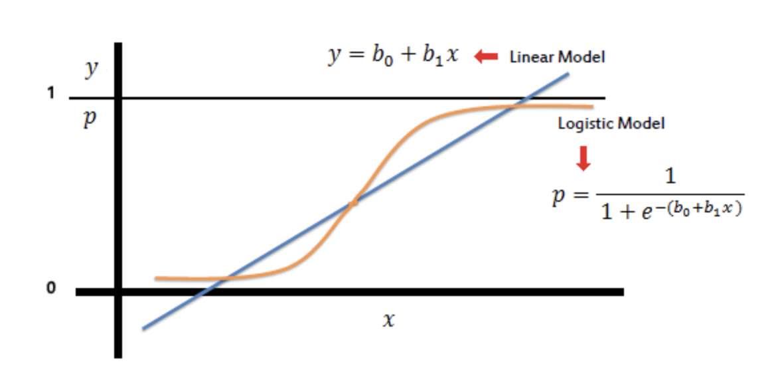
Analysis - Model Selection
Linear Regression (OLS)
TARGET = Restaurants with 4.5-5 Star Ratings
TARGET = 0.0285 x OutdoorSeating + 0.0439 x RestaurantsReservations + 0.1116 x Caters -0.0172 x NoiseLevel_average - 0.0503 x NoiseLevel_loud - 0.1115 x NoiseLevel_very_loud - 0.0737 x RestaurantsAttire_casual + 0.1565 x Street_Parking_ Fals + 0.2656 x Street_Parking_ True - 0.1084 x Alcohol_full_bar + 0.3183 x intimate_ True + 0.1093 x hipster_ True + 0.1104 x classy_ True + 0.1394 x upscale_ True
Logistic Regression (Logit)
TARGET = Restaurants with 4.5-5 Star Ratings
TARGET = [logit (-0.8085 x BusinessAcceptsCreditCards + 0.4376 x RestaurantsReservations + 0.7519 x Caters + 1.0093 x WheelchairAccessible - 0.4266 x NoiseLevel_loud - 2.6864 x NoiseLevel_very_loud - 1.1308 x RestaurantsAttire_casual - 1.2093 x RestaurantsAttire_dressy + 0.8316 x Street_Parking_ True + 0.8743 x Valet_ True - 0.4051 x Alcohol_beer_and_wine - 1.1175 x Alcohol_full_bar + 1.8494 x intimate_ True + 0.7620 x hipster_ True + 2.0950 x touristy_ True + 0.5984 x casual_ True - 0.8698 x breakfast_ True + 0.6753 x brunch_ True)]
Chosen
Notes:
Moving on to model selection. We worked through two types. However before going any further let's discuss the difference and make it obvious as to why we choose the following.
Logistic regression predicts the probability of an outcome that can only have two values (i.e. a dichotomy). The prediction is based on the use of one or several predictors (numerical and categorical). A linear regression is not appropriate for predicting the value of a binary variable for two reasons:
A linear regression will predict values outside the acceptable range (e.g. predicting probabilities outside the range 0 to 1)
Since the dichotomous experiments can only have one of two possible values for each experiment, the residuals will not be normally distributed about the predicted line.
On the other hand, a logistic regression produces a logistic curve, which is limited to values between 0 and 1. Logistic regression is similar to a linear regression, but the curve is constructed using the natural logarithm of the “odds” of the target variable, rather than the probability. Moreover, the predictors do not have to be normally distributed or have equal variance in each group.
We began with a linear regression using all remaining variables and further regressions with variables added or removed with the goal of improving our adjusted R-squared value. While we were able to develop this score to some degree, as the nature of our data was not quite linear in life, we chose to use logistic regression.
The interpretation is as follows:
Positive impact on our Target Variable: Accepts credit cards ,Restaurant Reservations, Catering, Wheelchair accessible, Street parking, valet parking, intimate setting, hipster setting, classy and upscale settings, touristy, casual true, offers brunch
Negative impact on our Target Variable: Loud Noise Levels, Noise level very loud, Restaurant attire casual, Restaurant attire very dressy, Alcohol beer and wine, full bar, and lastly offers breakfast

Slide 14
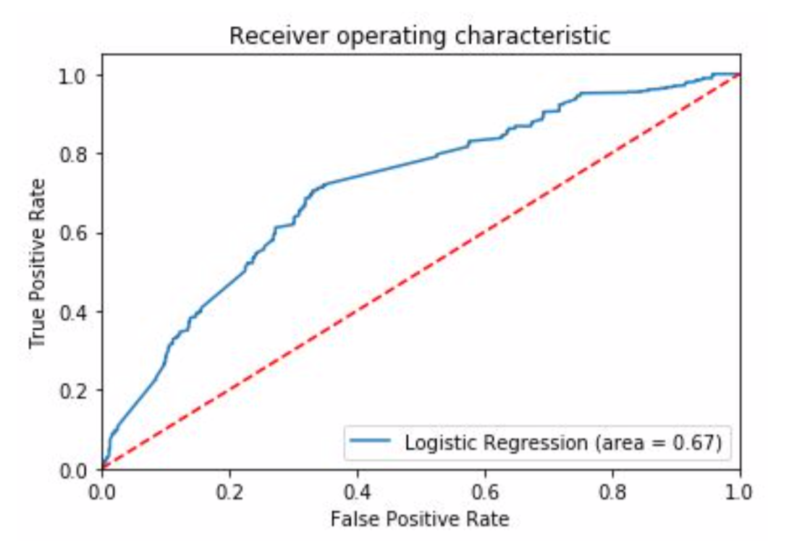
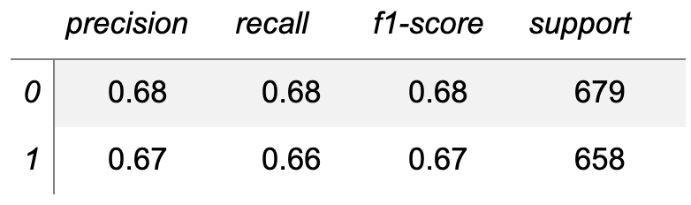
analysis
0.67 or 67%
Accuracy of logistic regression classifier on test set:
Notes:
Accuracy is one metric for evaluating classification models. Informally, accuracy is the fraction of predictions our model got right.
Our data were also split into test and training sets with 30% and 70% respectively split. We were able to reach 67% accuracy on our test dataset.

Slide 15
Conclusions
recommendations

Slide 16
conclusion
Positive impact on our Target Variable:
Accepts credit cards ,Restaurant Reservations, Catering, Wheelchair accessible, Street parking, valet parking, intimate setting, hipster setting, classy and upscale settings, touristy, casual true, offers brunch
Negative impact on our Target Variable:
Loud Noise Levels, Noise level very loud, Restaurant attire casual, Restaurant attire very dressy, Alcohol beer and wine, full bar, and lastly offers breakfast
Notes:
The interpretation is as follows:
Positive impact on our Target Variable: Accepts credit cards ,Restaurant Reservations, Catering, Wheelchair accessible, Street parking, valet parking, intimate setting, hipster setting, classy and upscale settings, touristy, casual true, offers brunch
Negative impact on our Target Variable: Loud Noise Levels, Noise level very loud, Restaurant attire casual, Restaurant attire very dressy, Alcohol beer and wine, full bar, and lastly offers breakfast

Slide 17
The Dashboard
Ongoing insights

Slide 18
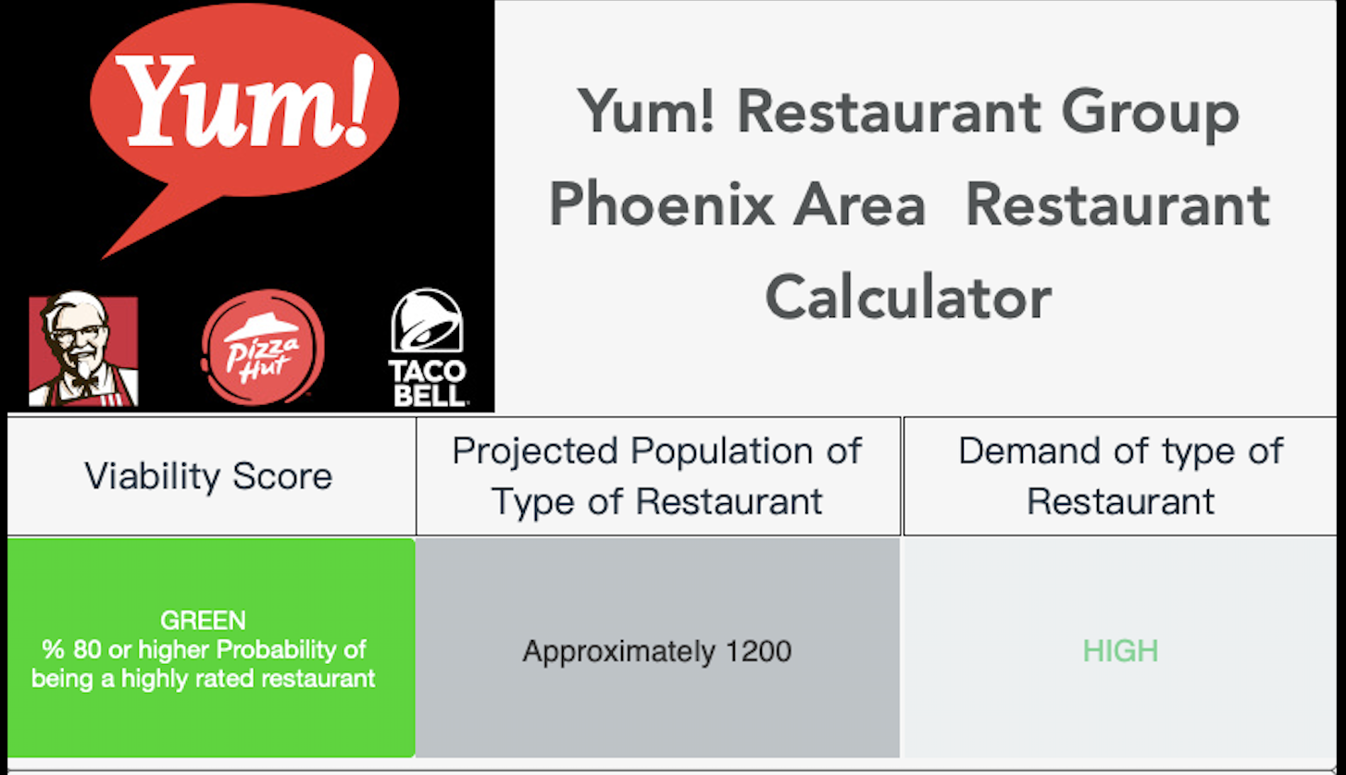
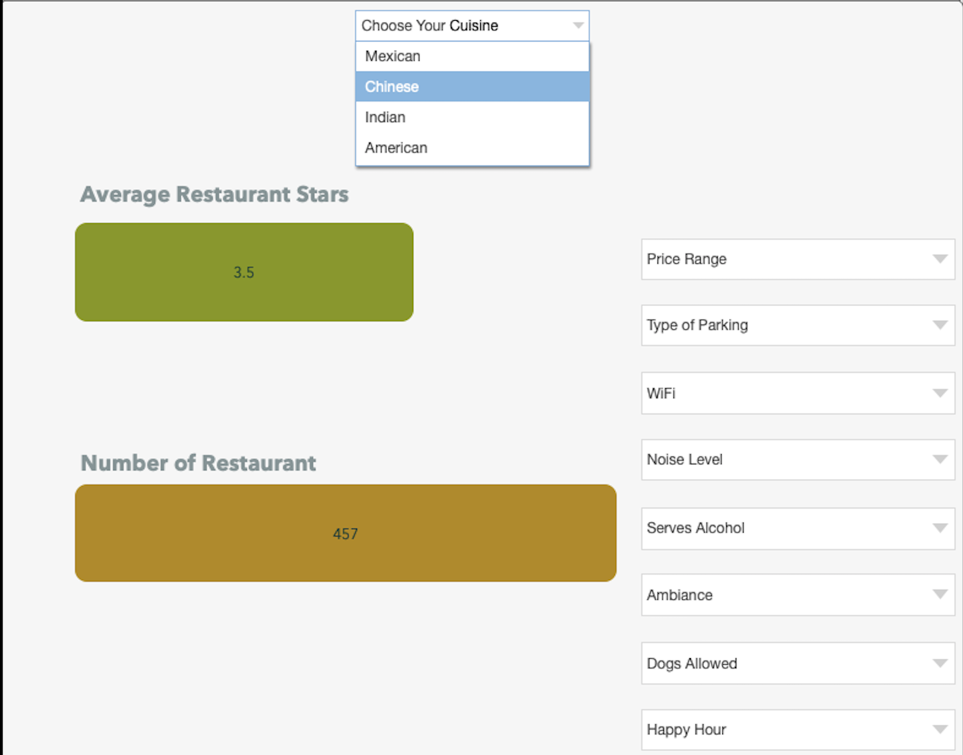
Dashboard
Notes:
The dashboards will consist of visual plots, maps, and charts with an explanation of what each graphic is used for and how to interrelate with each.
The top level of the dashboard will convey high level the viability score, the projected population of the type, and the demand of the restaurant given the selected attributes.
The second portion of the dashboard displayed to the right will show the calculated average number of stars given, selected attributes, and the number of restaurants that already exist given that specific combination.

Slide 19
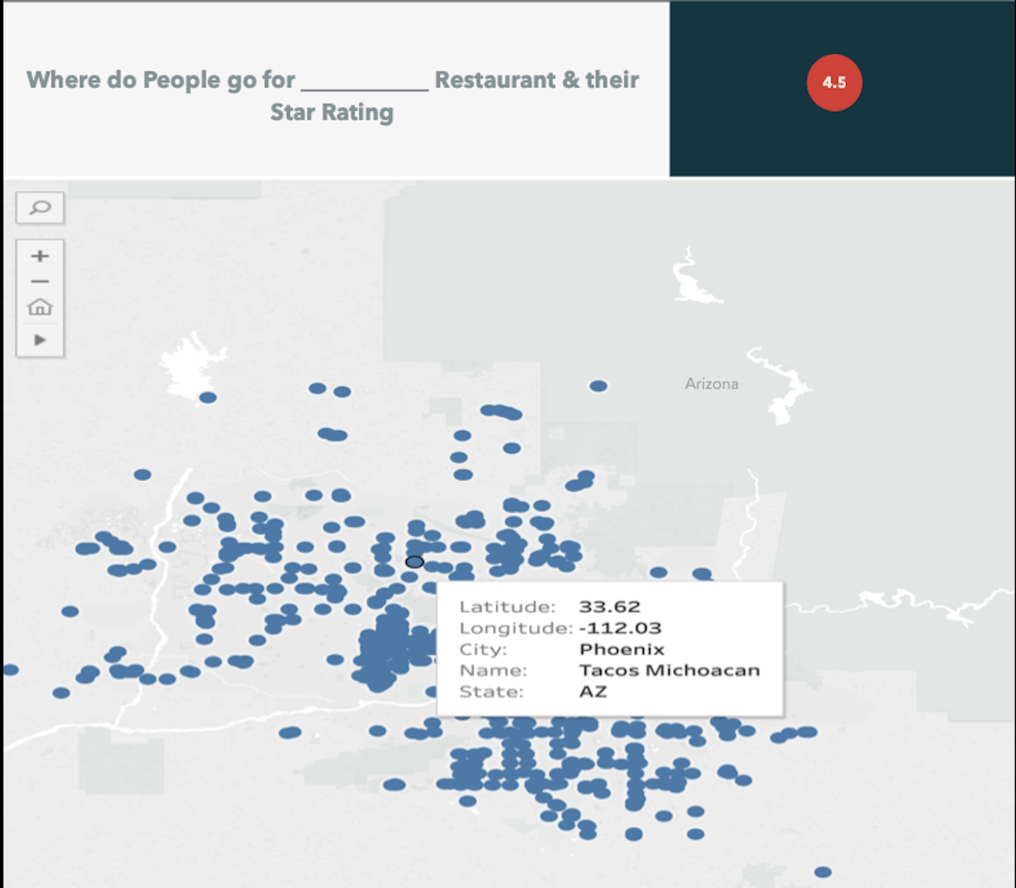
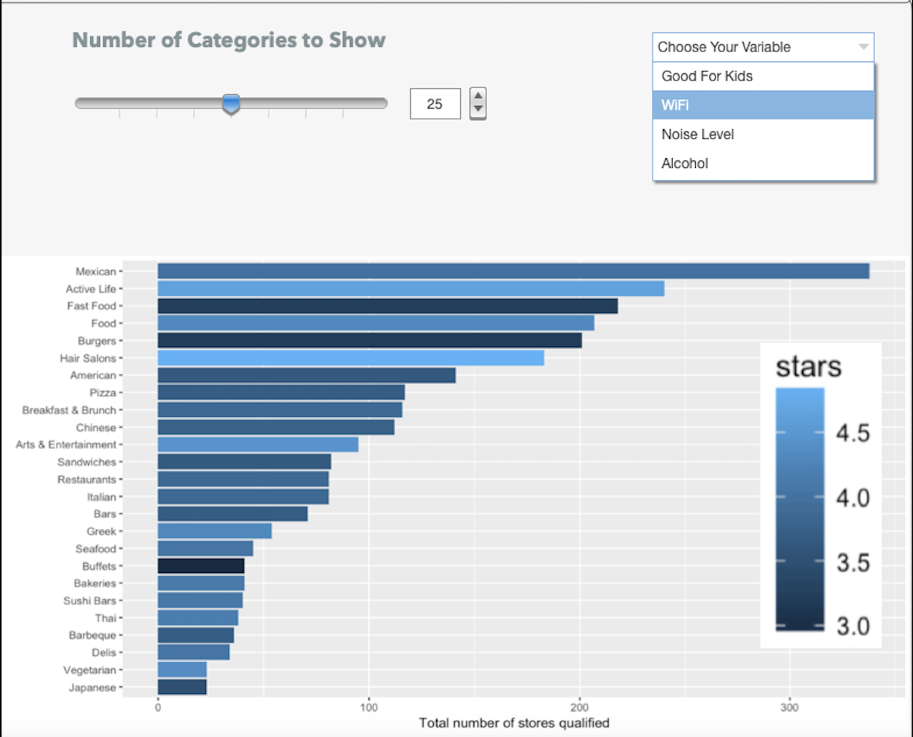
Conclusion
Notes:
The left panel of the dashboard will show the geographic location of the type of restaurant selected and its average stars based on historical data of existing restaurants just like it.
The right panel of the dashboard will allow our client to see the varying effects of particular attributes on the predicted star value of their restaurant.
Given these tools, we believe our client will feel empowered to make smart business decisions towards meeting their ultimate goal of opening a successful highly-rated restaurant in Phoenix, Arizona.
This conludes our presenation. Thank you very much!

